Slide 1
Customer Behaviour Analysis Project
Task 1
Objective: Customer Behaviour Analysis
Company: Alfido Tech
Tech Stack: Python(Pandas, Seaborn, Matplotlib)

Slide 2
01
Overview

Slide 3

Introduction
This project aims to analyze customer behavior to understand purchasing patterns, preferences, and trends.
The analysis helps uncover underlying factors influencing customer decisions in a competitive market environment.

Slide 4
Problem Statement
The primary goals are to identify and analyze key behavioral trends, segment customers by demographics and purchasing patterns, and generate strategic insights. These insights enable targeted marketing campaigns, optimized product offerings, and improved customer relationship management, ultimately driving business growth and competitive advantage in a dynamic market environment.

Slide 5
02
Data Cleaning

Slide 6
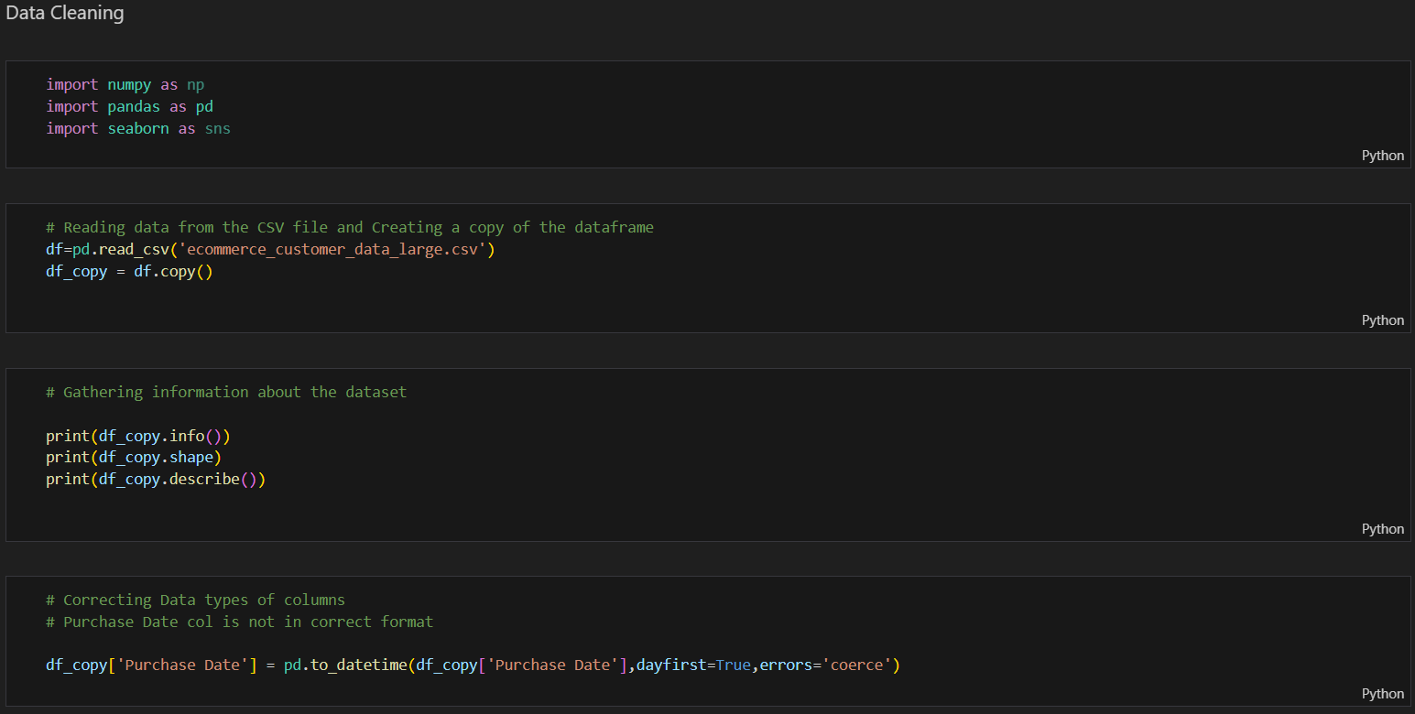
Importing Libraries and Reading Data from CSV File
We import NumPy, Pandas, and Seaborn to handle numerical operations, data manipulation, and visualization. The CSV file is read into a Pandas DataFrame, and a copy is created to preserve the original dataset for safe analysis.

Slide 7
Gathering Information about the Dataset
The dataset is first explored to gain a clear understanding of its structure and contents. Using info(), we can check the column names, data types, and presence of null values. The shape attribute provides the number of rows and columns, helping us gauge the dataset’s size. Finally, describe() generates summary statistics such as mean, median, minimum, maximum, and standard deviation for numerical columns, giving an initial overview of the data distribution and helping identify any irregularities or patterns.

Slide 8
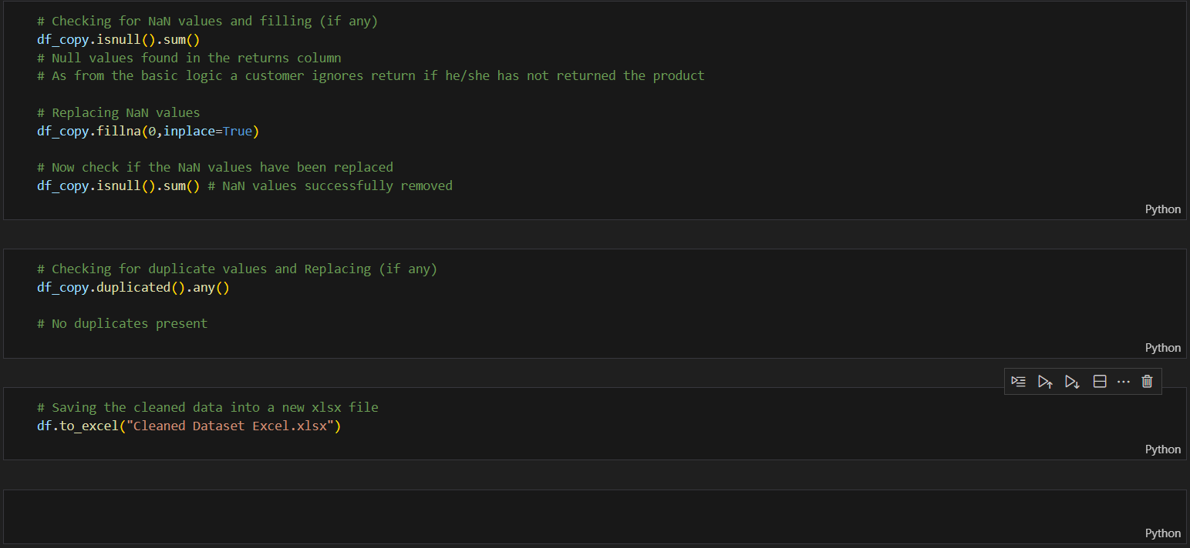
Data Cleaning Code 1
In this step, the dataset is cleaned to make it ready for analysis. The Purchase Date column is converted into a proper datetime format to ensure consistency. Next, the dataset is checked for any missing values using isnull().sum(), and null entries are handled by replacing them with zeros using fillna(0, inplace=True). This ensures that the data remains complete, avoids calculation errors, and maintains logical consistency, especially in cases like returns where a missing value can reasonably be treated as zero.

Slide 9
Data Cleaning Code 2
The dataset is further cleaned by checking for duplicate records using duplicated().any(), ensuring that each entry is unique and reliable. Since no duplicates are found, the data is already consistent. Finally, the cleaned dataset is saved into a new Excel file using to_excel(), making it ready for future analysis and reporting.

Slide 10
03
Data Visualization and Analysis

Slide 11

Visuals Used
The analysis incorporated various visual tools including bar charts, pie charts, KPI’s, tables, and scatter plots to illustrate customer segmentation, purchase behaviors, and Payment mode preferences. These visualizations enhance data comprehension by clearly highlighting significant trends, relationships, and outliers, thereby facilitating informed decision-making and strategic planning.

Slide 12
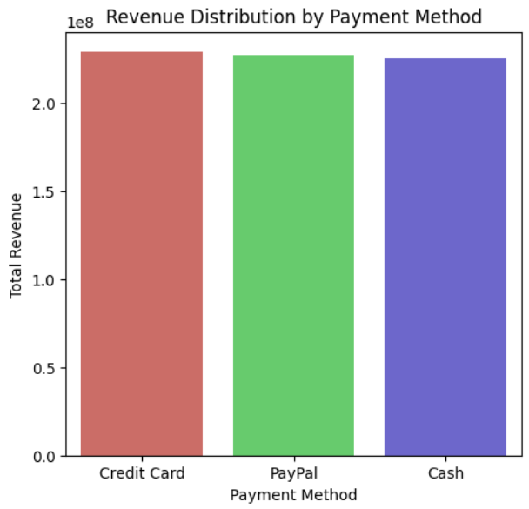
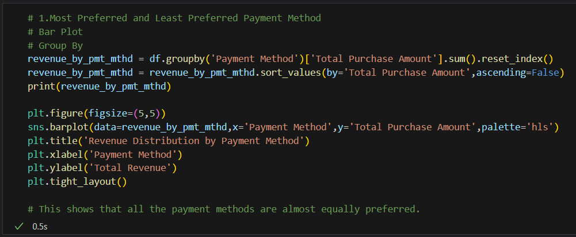
Visual 1
From this visualization, we can infer that all three payment methods—Credit Card, PayPal, and Cash—generate nearly the same amount of revenue. This indicates that customers do not have a strong preference for any specific payment method, and all options are almost equally popular. It also suggests that offering multiple payment methods helps cater to diverse customer choices without significantly impacting overall revenue distribution.

Slide 13
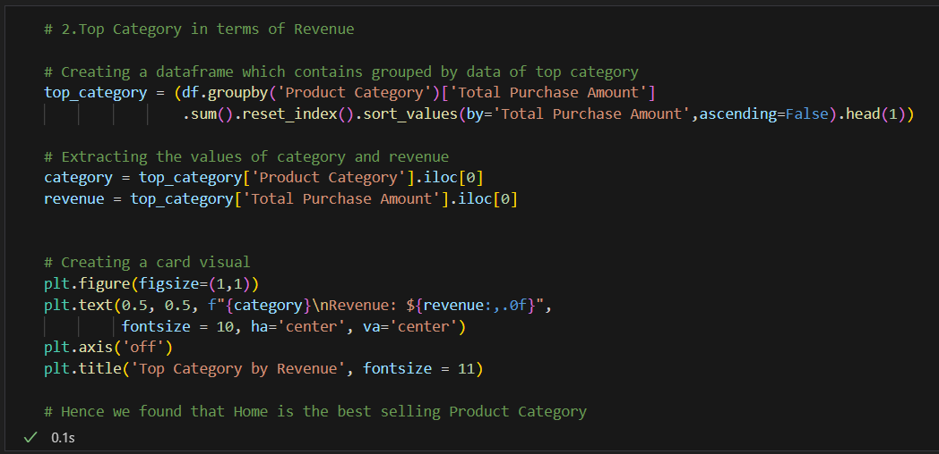
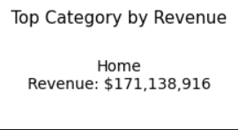
Visual 2
The analysis shows that the Home category generates the highest revenue, amounting to $171,138,916. This indicates that products under the Home category are the most popular and contribute the most to overall sales, making it the best-performing category in terms of revenue.

Slide 14
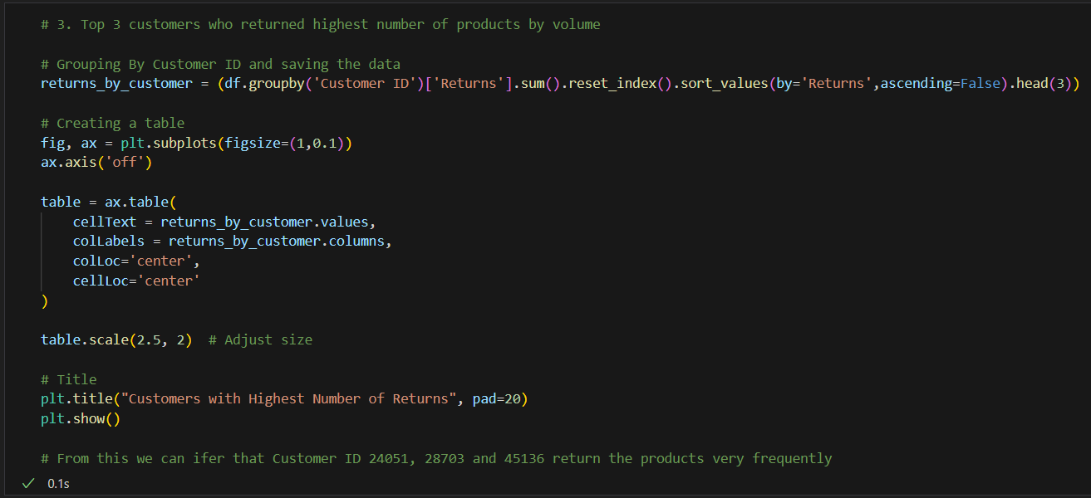
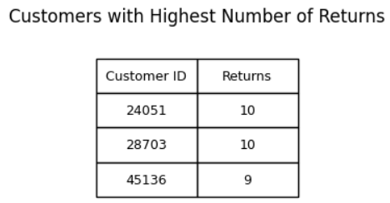
Visual 3
The insight from this analysis shows that customers with IDs 24051, 28703, and 45136 have the highest number of product returns, with 10, 10, and 9 returns respectively. This indicates that these customers frequently return items, which may suggest dissatisfaction, product quality issues, or unusual buying behavior. Monitoring such customers and identifying potential reasons behind frequent returns can help improve customer experience and reduce return-related losses.

Slide 15
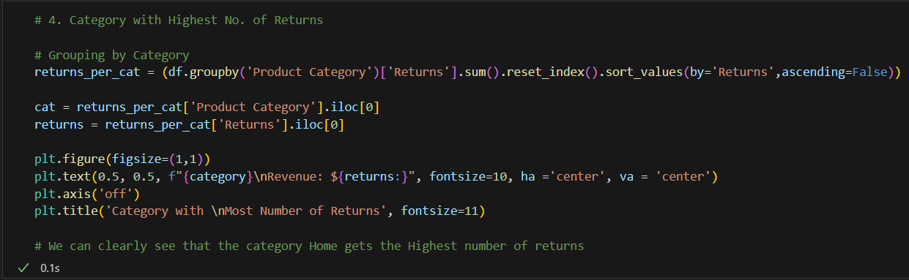
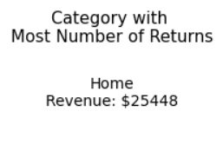
Visual 4
The analysis reveals that the Home category records the highest number of returns, with a return value of $25,448. While this category also generates the highest revenue, it simultaneously faces the most product returns, which could indicate potential issues such as product quality concerns, mismatched customer expectations, or logistics challenges. This insight highlights the need for deeper investigation into why returns are concentrated in this category.

Slide 16
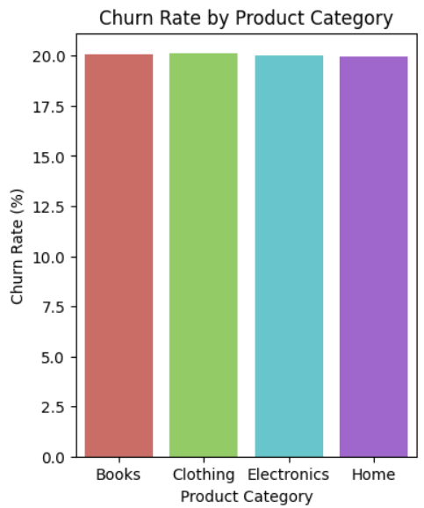
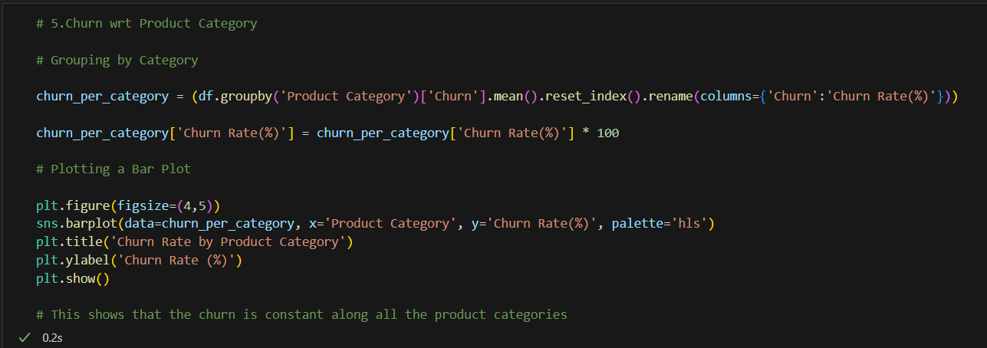
Visual 5
The churn analysis across product categories shows that the churn rate is nearly constant at around 20% for all categories—Books, Clothing, Electronics, and Home. This suggests that customer drop-off behavior is not strongly influenced by the type of product purchased, and other factors such as pricing, service quality, or overall customer experience might be driving churn uniformly across categories.

Slide 17
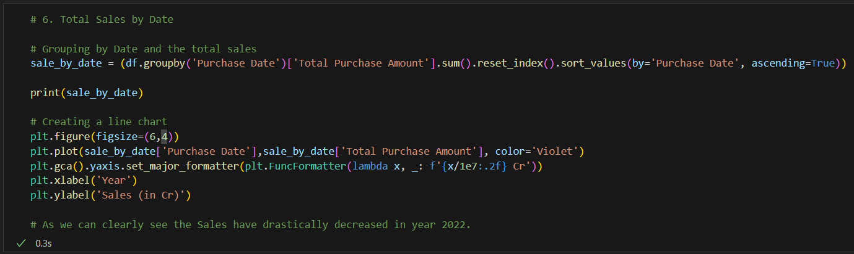
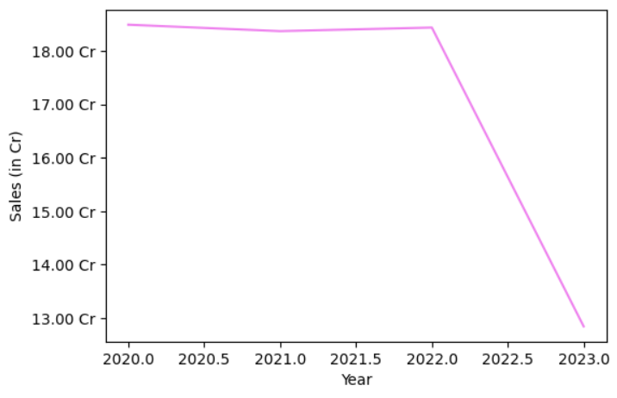
Visual 6
The trend of total sales over time shows that revenues remained fairly steady from 2020 through 2021, with only slight fluctuations. However, there is a sharp decline in sales during 2022, indicating a major drop in customer purchases. This downward trend could be due to external factors such as market shifts, reduced demand, or operational challenges, and it highlights the need for deeper investigation to understand the cause of this decline.

Slide 18
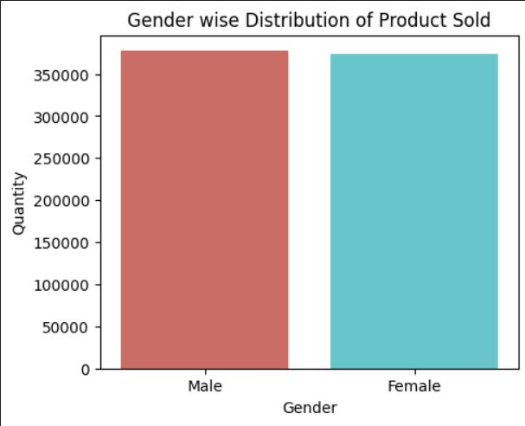
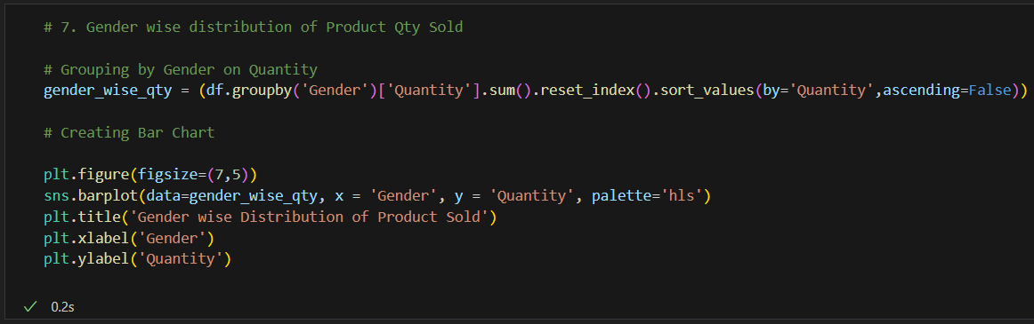
Visual 7
The gender-wise distribution of product sales shows that both male and female customers contributed almost equally to the total quantity sold, with only a slight edge for male customers. This indicates a balanced demand across genders, suggesting that products appeal broadly without strong gender-specific preferences. Such insights can help businesses focus on inclusive marketing strategies rather than targeting only one demographic.

Slide 19
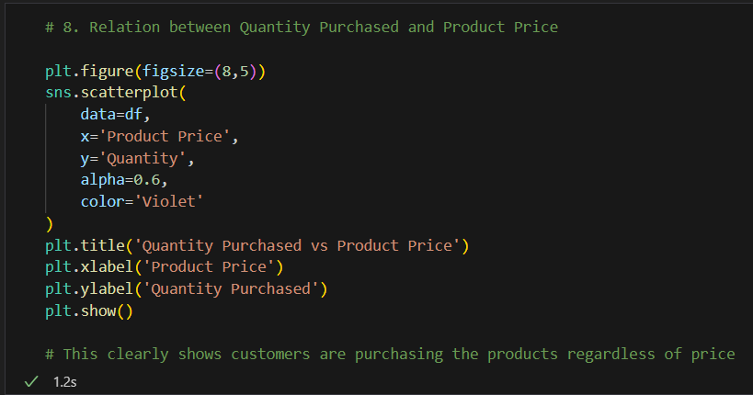
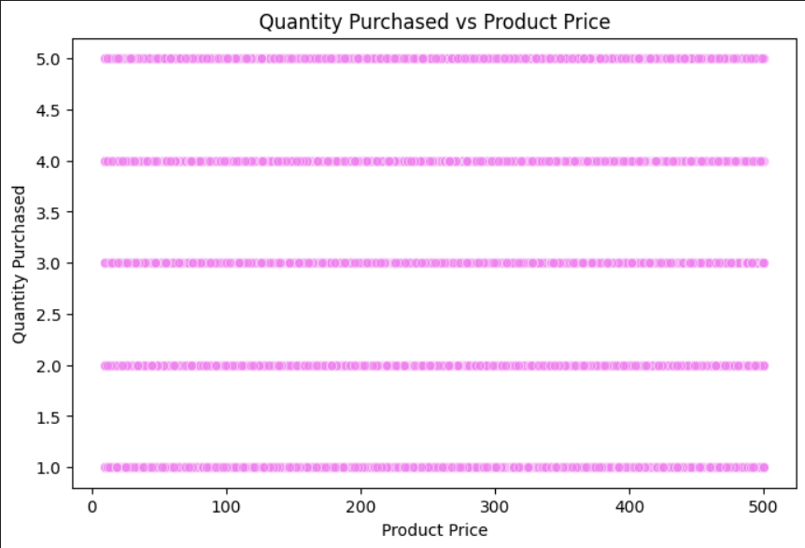
Visual 8
The relationship between product price and quantity purchased reveals that customers tend to buy products consistently across different price ranges. The scatterplot shows no significant correlation between higher prices and lower quantities, indicating that demand remains steady regardless of product cost. This suggests that customer purchase decisions are not heavily influenced by price, highlighting strong product appeal or brand loyalty.

Slide 20
04
Insights and Decision Making

Slide 21

Key Insights
1. Customers use all payment methods (Credit Card, PayPal, Cash) almost equally, showing no dominant preference.
2. The Home category generates the highest revenue ($171M+), but also records the largest number of returns ($25K+).
3. A few specific customers are responsible for frequent product returns, indicating possible dissatisfaction or unusual buying behavior.
4. Churn rate is steady at around 20% across all product categories, suggesting customer drop-off is not category-specific.
5. Sales remained stable during 2020–2021 but experienced a sharp decline in 2022, raising concerns about retention or market changes.
6. Gender-wise sales distribution shows near-equal contributions from male and female customers, reflecting balanced demand across demographics.
7. Price vs. Quantity analysis indicates no significant link between higher prices and lower purchase quantities, suggesting demand is not strongly price-sensitive.

Slide 22
Recommendations for Decision Makers
1. Investigate the high return rate in the Home category by improving product quality checks, enhancing descriptions, and strengthening after-sales service.
2. Continue offering multiple payment options to maintain customer convenience and inclusivity.
3. Address the consistent churn rate by introducing loyalty programs, personalized offers, and better engagement initiatives to retain customers across categories.
4. Examine the 2022 sales decline through customer feedback, competitive analysis, and market research, followed by corrective actions such as targeted promotions or pricing adjustments.
5. Leverage the balanced gender demand by designing inclusive marketing campaigns that appeal to both male and female customers.
6. Take advantage of the price-insensitive demand by introducing premium product lines, bundling strategies, or upselling opportunities, while ensuring strong brand positioning and product quality.

Slide 23



Thank you!
If you have any questions?
Connect on Socials.

